Slide 1
Information Processing Techniques
Week 01
Abeeha Sattar

Slide 2
Let’s Introduce Ourselves
Name: Abeeha Sattar
Qualifications: MS(CS) from IBA (2020), BS(CS) from FAST-NUCES (2016)
Experience: Worked in Systems Ltd. for about 1.5 years.
Tell me… your name, hobbies , your field of interest, and
your expectations from this course.

Slide 3
Office Location
Basement - II, Room # 16
Just check the time table before visiting!

Slide 4
Pre- Requisites
The course assumes that you have prior knowledge on the following:
Software Engineering
Programming Basics

Slide 5
Course Outline
- You may find the course outline on Google Classroom.
- Assignments:
Assignment # 1 – Week 3
Assignment # 2 – Week
- Quizzes
- Project:
Project Proposal – Week 2
Project SRS – Week 5
Project SDS, UI – Week 10
Project Presentations and Demos – Week 16

Slide 6
Grading Scheme
Assignments 5 %
Quizzes 5 %
Project 10 %
Midterms (2) 30 %
Final 50 %

Slide 7
Assignments Policies
No late submissions
Plagiarism on 1st assignment: 0 for that question
Plagiarism on 2nd assignment: 0 for that assignment

Slide 8
Reference Books
Clean Code: A Handbook of Agile Software Craftsmanship 1st Edition by Robert C.
Martin
Head First Design Patterns by Eric Freeman, Elisabeth Robson
Refactoring - Improving the Design of Existing Code by Martin Fowler, with Kent Beck
Software Architecture Patterns by Mark Richards, O’Reilly Media, Inc., 2015

Slide 9
Introduction to Java

Slide 10
History of Java
Java was originally developed by Sun Microsystems starting in 1991
– James Gosling
– Patrick Naughton
– Chris Warth
– Ed Frank
– Mike Sheridan
This language was initially called “Oak”
Renamed Java in 1995

Slide 11
What is Java?
A simple, object‐oriented, distributed, interpreted, robust, secure, architecture neutral, portable, high‐performance, multithreaded, and dynamic language

Slide 12
Object‐Oriented
– No free functions
– All code belong to some class
– Classes are in turn arranged in a hierarchy or package structure

Slide 13
Distributed
– Fully supports IPv4, with structures to support IPv6
– Includes support for Applets: small programs embedded in HTML documents

Slide 14
Interpreted
– The program are compiled into Java Virtual Machine (JVM) code called bytecode
– Each bytecode instruction is translated into machine code at the time of execution

Slide 15
Robust
– Java is simple
– no pointers/stack concerns
– Exception handling
– try/catch/finally series allows for simplified error recovery
– Strongly typed language – many errors caught during compilation

Slide 16
Java Development Environment
Edit – Create/edit the source code
Compile – Compile the source code
Load – Load the compiled code
Verify – Check against security restrictions
Execute – Execute the compiled

Slide 17
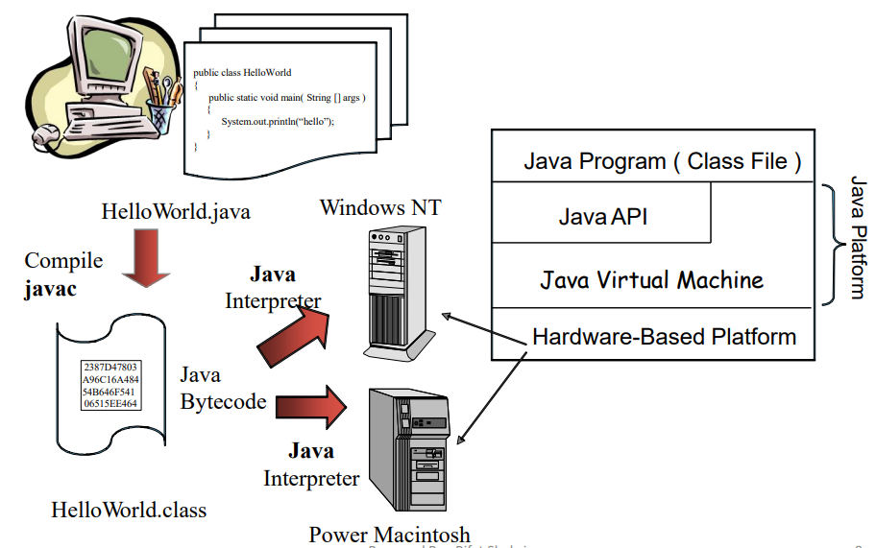
Java Platform

Slide 18
Bytecode
They are not machine language binary code
They are independent of any particular microprocessor or hardware platform
They are platform‐independent instructions
Another entity (interpreter) is required to convert the bytecodes into machine codes that the underlying microprocessor understands
This is the job of the JVM (Java Virtual Machine)

Slide 19
JVM (Java Virtual Machine)
It is a part of the JDK and the foundation of the Java platform
It can be installed separately or with JDK
A virtual machine (VM) is a software application that simulates a computer, but hides the underlying operating system and hardware from the programs that interact with the VM
It is the JVM that makes Java a portable language

Slide 20
JVM (Java Virtual Machine)
The same bytecodes can be executed on any platform containing a compatible JVM
The JVM is invoked by the java command – java Welcome
It searches the class Welcome in the current directory and executes the main method of class Welcome
It issues an error if it cannot find the class Welcome or if class Welcome does not contain a method called main with proper signature

Slide 21
JIT Compiler
When a JIT compiler is part of the JVM, selected portions of bytecode are compiled into executable code in real time, on a piece-by-piece, demand basis.
An entire Java program is not compiled into executable code all at once, in this case.
Not all sequences of bytecode are compiled—only those that will benefit from compilation.
The remaining code is simply interpreted.

Slide 22
Commands for Reference:
Use javac <filename>.java to compile a java file using the command prompt
Use java <classname> to execute the class file that was generated by the javac command.

Slide 23
Fin.

Slide 24
Software Construction & Development
Week 03
Abeeha Sattar

Slide 25
Layered Architecture

Slide 26
Layered Application Architecture
Presentation layer
Concerned with presenting the results of a computation to system users and with collecting user inputs
Application processing layer
Concerned with providing application specific functionality e.g., in a banking system, banking functions such as open account, close account, etc.
Data management layer
Concerned with managing the system databases
Notes:
Logical Separation of functionalities

Slide 27
Tiering
A two-tier architecture is one where a client talks directly to a server, with no intervening server
This type of architecture is typically used in small environments with less than 50 users
A three-tier architecture introduces another server (or an "agent") between the client and the server
The role of the middle-tier agent is many-fold - it can provide translation services as in adapting a legacy application on a mainframe to a client/server environnent
A plethora of software technologies have evolved to fill the middle tier - middleware
Notes:
Physical Separation/ Physical Machines

Slide 28
MVC Pattern
- Model
Model represents an object or JAVA POJO carrying data. It can also have logic to update controller if its data changes.
- View
View represents the visualization of the data that model contains.
- Controller
Controller acts on both model and view. It controls the data flow into model object and updates the view whenever data changes. It keeps view and model separate.
Notes:
POJO = Plain Old Java Object
It is an ordinary Java object, not bound by any special restriction other than those forced by the Java Language Specification and not requiring any classpath. POJOs are used for increasing the readability and re-usability of a program.

Slide 29
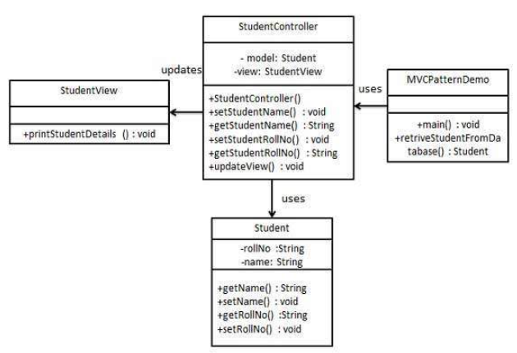
Example
Notes:
https://www.tutorialspoint.com/design_pattern/mvc_pattern.htm

Slide 30
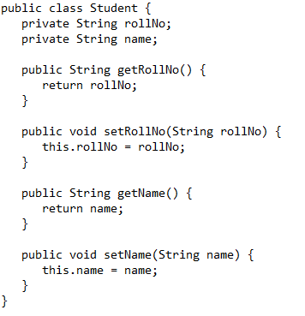
Student.java

Slide 31
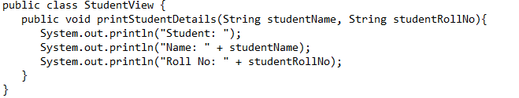
StudentView.java

Slide 32
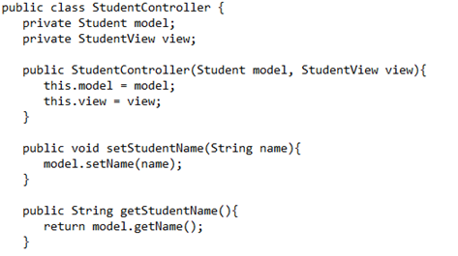
StudentController.java

Slide 33
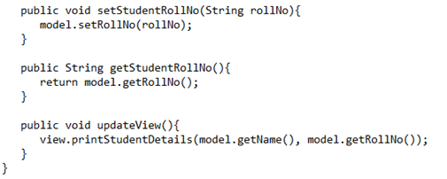
StudentController.java

Slide 34
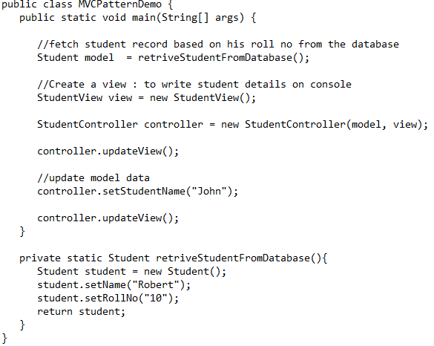
MVCPatternDemo.java

Slide 35
DAO Pattern
- Data Access Object
Has the following:
Data Access Object Interface - This interface defines the standard operations to be performed on a model object(s).
Data Access Object concrete class - This class implements above interface. This class is responsible to get data from a data source which can be database / xml or any other storage mechanism.
Model Object or Value Object - This object is simple POJO containing get/set methods to store data retrieved using DAO class.
Notes:
Data Access Object Pattern or DAO pattern is used to separate low level data accessing API or operations from high level business services.

Slide 36
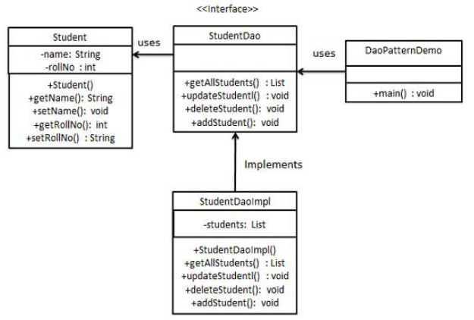
Example
Notes:
https://www.tutorialspoint.com/design_pattern/data_access_object_pattern.htm

Slide 37
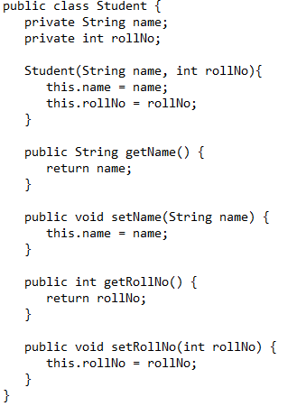
Student.java

Slide 38
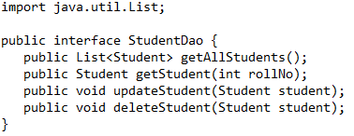
StudentDao.java

Slide 39
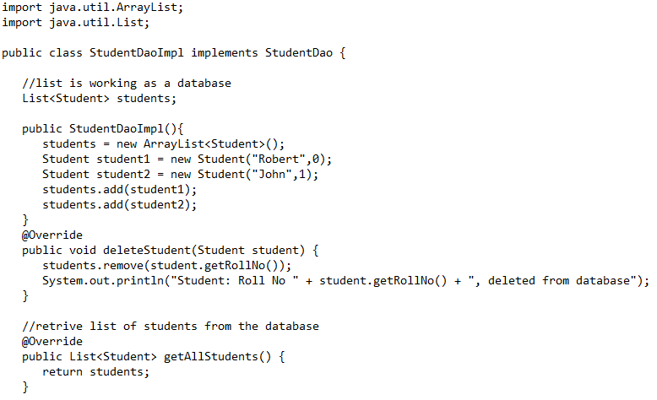
StudentDaoImpl.java

Slide 40
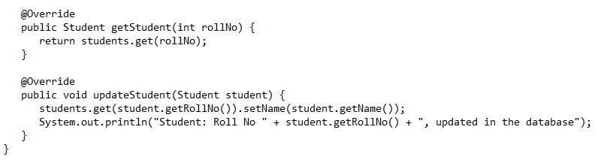
StudentDaoImpl.java

Slide 41
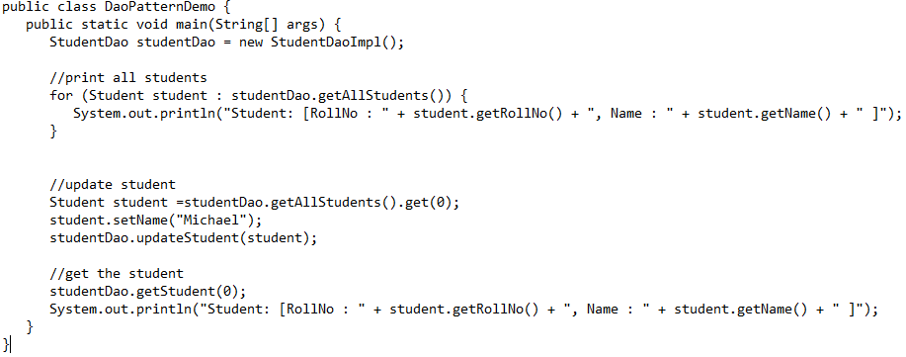
DaoPatternDemo.java

Slide 42
Fin.

Slide 43
Software Construction & Development
Week 03
Abeeha Sattar

Slide 44
Event-Driven Programming

Slide 45
What is Event-Driven Programming?
It is a programming paradigm in which the flow of a program is driven by events.

Slide 46
Event Handling
Chapter # 24

Slide 47
The Delegation Event Model
It defines standard and consistent mechanisms to generate and process events.
The Concept:
A source generates an event and sends it to one or more listeners

Slide 48
Event
An event is an object that describes a state change in a source.
An event can be generated as a consequence of a person interacting with the elements in a graphical user interface.
Pressing a button, entering a character via the keyboard, etc.
An event may also be generated when:
A timer expires
A counter exceeds a value
A software or hardware failure occurs
An operation is completed

Slide 49
Event Sources
A source is an object that generates an event.
Sources may generate more than one type of event.
A source must register listeners (why…?)
A listener register method looks like:
public void addTypeListener (TypeListener el )
Type = name of event
el = reference of the event listener

Slide 50
Event Sources
A source must also provide a method that allows a listener to unregister an interest in a specific type of event.
A listener unregister method looks like:
public void removeTypeListener(TypeListener el )
Type = name of event
el = reference of the event listener

Slide 51
Multicasting & Unicasting an Event
Multicasting:
When an event occurs, all registered listeners are notified and receive a copy of the event object.
Unicasting:
Some sources may allow only one listener to register. When an event occurs, the registered listener is notified.
These methods throw an exception when more than one listener try to connect to it.
Notes:
The methods that allow only one listener to register look like:
public void addTypeListener(TypeListener el ) throws java.util.TooManyListenersException

Slide 52
Event Listeners
A listener is an object that is notified when an event occurs.
It has two requirements:
Must be registered with one or more listeners
Must implement methods to receive and process
An event handler must return quickly, and must not maintain control for an extended period. (Why?)

Slide 53
Event Classes
The classes that represent events are at the core of Java’s event handling mechanism.
EventObject is a superclass of all events.
AWTEvent is a superclass of all AWT events that are handled by the delegation event model.

Slide 54
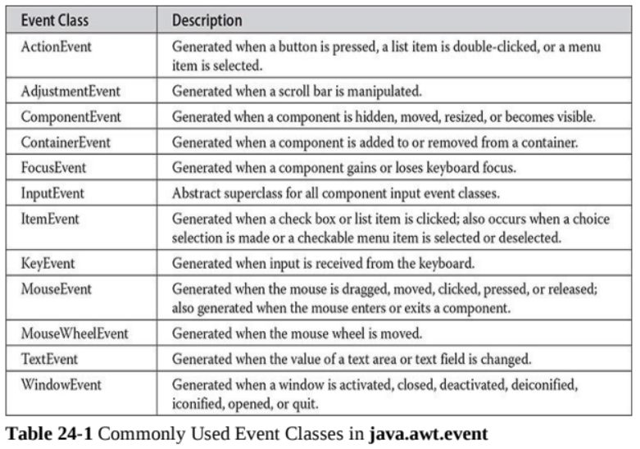

Slide 55
Event Classes
The ActionEvent Class
An ActionEvent is generated when a button is pressed, a list item is double-clicked, or a menu item is selected.
The AdjustmentEvent Class
An AdjustmentEvent is generated by a scroll bar.
The ComponentEvent Class
A ComponentEvent is generated when the size, position, or visibility of a component is changed.
The ContainerEvent Class
A ContainerEvent is generated when a component is added to or removed from a container.

Slide 56
Event Classes
The FocusEvent Class
A FocusEvent is generated when a component gains or loses input focus.
The InputEvent Class
The abstract class InputEvent is a subclass of ComponentEvent and is the superclass for component input events. Its subclasses are KeyEvent and MouseEvent.
The ItemEvent Class
An ItemEvent is generated when a check box or a list item is clicked or when a checkable menu item is selected or deselected.

Slide 57
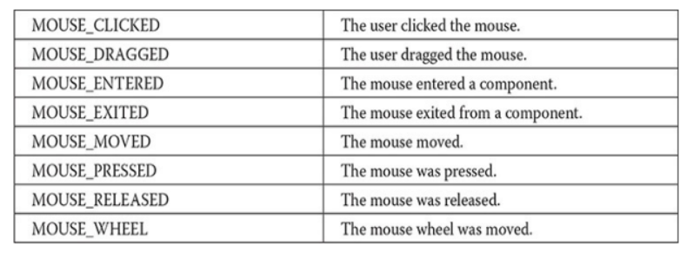
Event Classes
The KeyEvent Class
A KeyEvent is generated when keyboard input occurs. (KEY_PRESSED, KEY_RELEASED, KEY_TYPED)
The MouseEvent Class

Slide 58
Event Classes
The MouseWheelEvent Class
The MouseWheelEvent class encapsulates a mouse wheel event. It is a subclass of MouseEvent.
The TextEvent Class
Instances of this class describe text events. These are generated by text fields and text areas when characters are entered by a user or program.

Slide 59
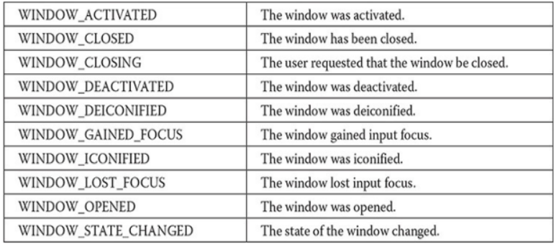
Event Classes
The WindowEvent Class

Slide 60
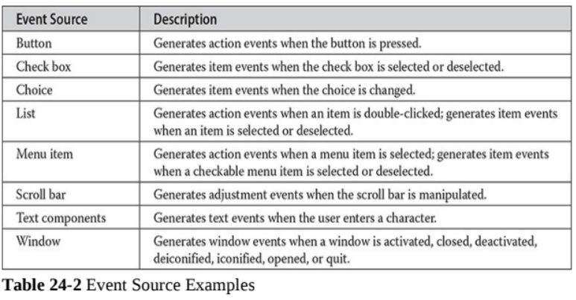
Sources of Events

Slide 61
Event Listener Interfaces
Listeners are created by implementing one or more of the interfaces defined by the java.awt.event package.
When an event occurs, the event source invokes the appropriate method defined by the listener and provides an event object as its argument.

Slide 62
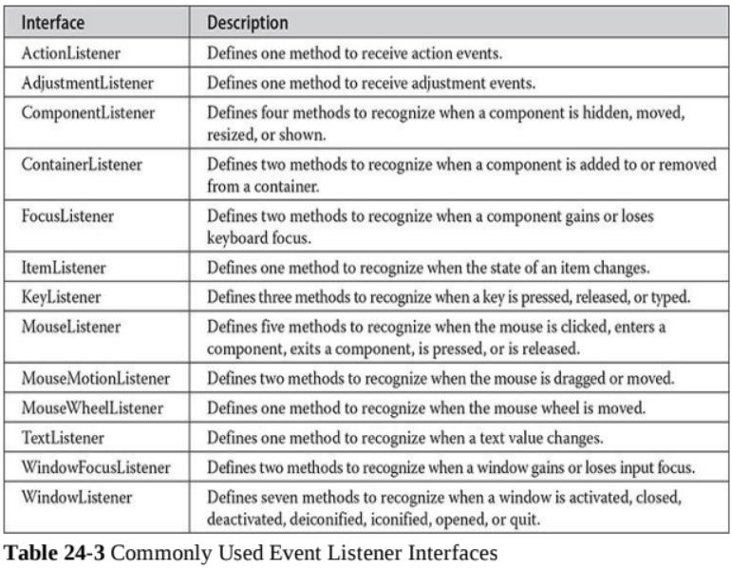

Slide 63
Examples
Mouse events & keyboard Events

Slide 64
Adapter Classes
An adapter class provides an empty implementation of all methods in an event listener interface.
Why would we want Adapter Classes?
Adapter classes are useful when you want to receive and process only some of the events that are handled by a particular event listener interface.

Slide 65
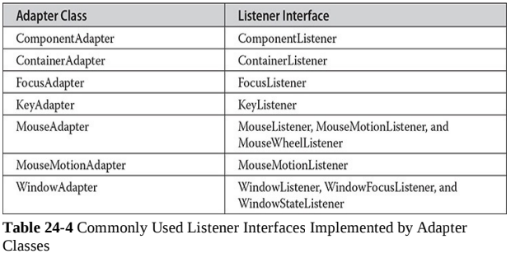
Adapter Classes

Slide 66
Example
Adapter Classes

Slide 67
Inner Classes
A class which is defined within another class, or within an expression.

Slide 68
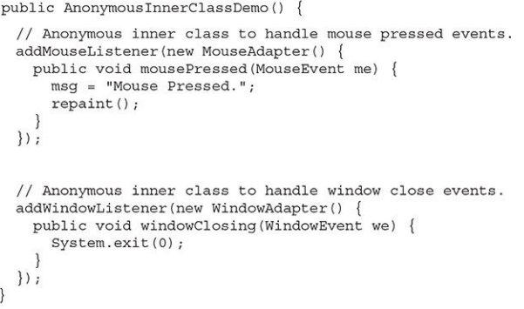
Anonymous Inner Classses
An anonymous inner class is an inner class that is not assigned a name
This is a constructor

Slide 69
Fin.

Slide 70
Software Construction & Development
Week 02
Abeeha Sattar

Slide 71
Layered Architecture

Slide 72
Layered Application Architecture
Presentation layer
Concerned with presenting the results of a computation to system users and with collecting user inputs
Application processing layer
Concerned with providing application specific functionality e.g., in a banking system, banking functions such as open account, close account, etc.
Data management layer
Concerned with managing the system databases
Notes:
Logical Separation of functionalities

Slide 73
Tiering
A two-tier architecture is one where a client talks directly to a server, with no intervening server
This type of architecture is typically used in small environments with less than 50 users
A three-tier architecture introduces another server (or an "agent") between the client and the server
The role of the middle-tier agent is many-fold - it can provide translation services as in adapting a legacy application on a mainframe to a client/server environnent
A plethora of software technologies have evolved to fill the middle tier - middleware
Notes:
Physical Separation/ Physical Machines

Slide 74
MVC Pattern
- Model
Model represents an object or JAVA POJO carrying data. It can also have logic to update controller if its data changes.
- View
View represents the visualization of the data that model contains.
- Controller
Controller acts on both model and view. It controls the data flow into model object and updates the view whenever data changes. It keeps view and model separate.
Notes:
POJO = Plain Old Java Object
It is an ordinary Java object, not bound by any special restriction other than those forced by the Java Language Specification and not requiring any classpath. POJOs are used for increasing the readability and re-usability of a program.

Slide 75
Example
Notes:
https://www.tutorialspoint.com/design_pattern/mvc_pattern.htm

Slide 76
DAO Pattern
- Data Access Object
Has the following:
Data Access Object Interface - This interface defines the standard operations to be performed on a model object(s).
Data Access Object concrete class - This class implements above interface. This class is responsible to get data from a data source which can be database / xml or any other storage mechanism.
Model Object or Value Object - This object is simple POJO containing get/set methods to store data retrieved using DAO class.
Notes:
Data Access Object Pattern or DAO pattern is used to separate low level data accessing API or operations from high level business services.

Slide 77
Example
Notes:
https://www.tutorialspoint.com/design_pattern/data_access_object_pattern.htm

Slide 78
Fin.

